Slide 1


Electric Circuits
Twelfth Edition, Global Edition
Chapter 4 – Part 7
Techniques of Circuit Analysis
© 2024 Pearson Education Ltd. All Rights Reserved.
Notes:
If this PowerPoint presentation contains mathematical equations, you may need to check that your computer has the following installed:
1) Math Type Plugin
2) Math Player (free versions available)
3) NVDA Reader (free versions available)

Slide 2
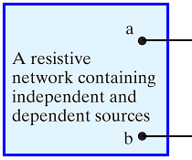
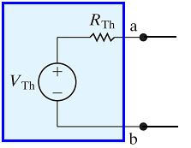





Chapter 4 – techniques of circuit analysis (1 of 17)
Thevenin and Norton equivalents
A circuit simplification technique
Can be applied to any circuit consisting of resistors and sources
Finding the Thevenin equivalent is a two-step process:
  Find the open-circuit voltage,
  Find the short-circuit current,
Then,
and

Slide 3
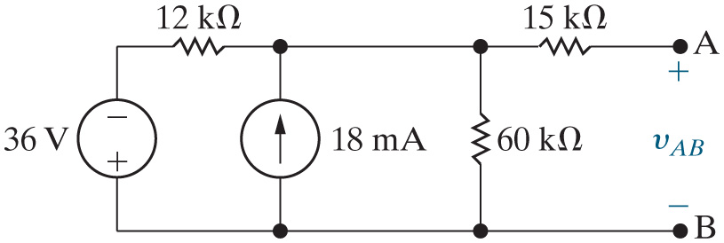

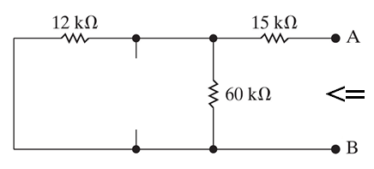


Chapter 4 – techniques of circuit analysis (2 of 17)
Thevenin and Norton equivalents
Find the Norton equivalent of the circuit shown here.
Find

Slide 4

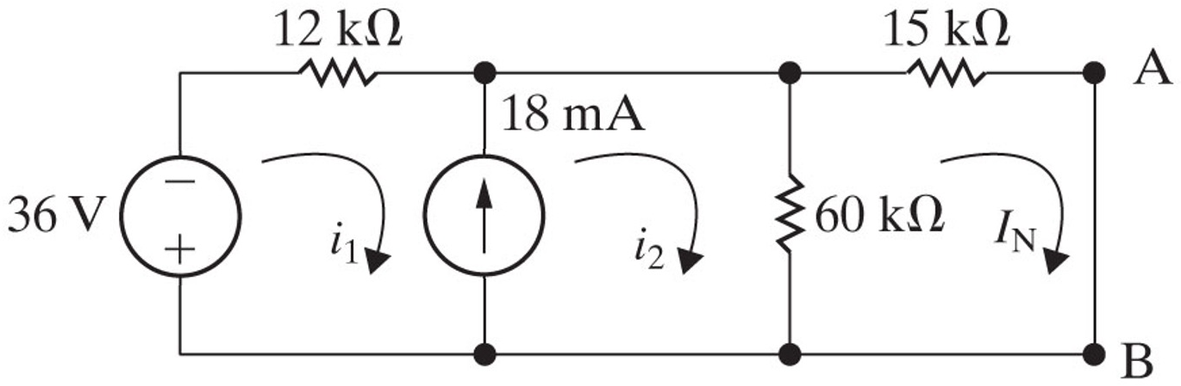





Chapter 4 – techniques of circuit analysis (3 of 17)
Thevenin and Norton equivalents
Find the Norton equivalent of the circuit shown here (continued).
Find
using the mesh current method:
supermesh:
mesh:
S M constraint:
Solving:

Slide 5
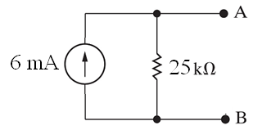
Chapter 4 – techniques of circuit analysis (4 of 17)
Thevenin and Norton equivalents
Find the Norton equivalent of the circuit shown here (continued).
Draw the Norton equivalent:

Slide 6
Chapter 4 – techniques of circuit analysis (5 of 17)
Thevenin and Norton equivalents
Special cases:
  Does the circuit have a dependent source? If so, you must calculate the open-circuit voltage and the short-circuit current, because you cannot “kill” the independent source(s) and make series and parallel combinations of resistors to find the Thevenin resistance.
  Does the circuit have dependent sources but no independent sources? If so, the Thevenin voltage and Norton current are both zero! You have to calculate the Thevenin resistance using the test source method.

Slide 7
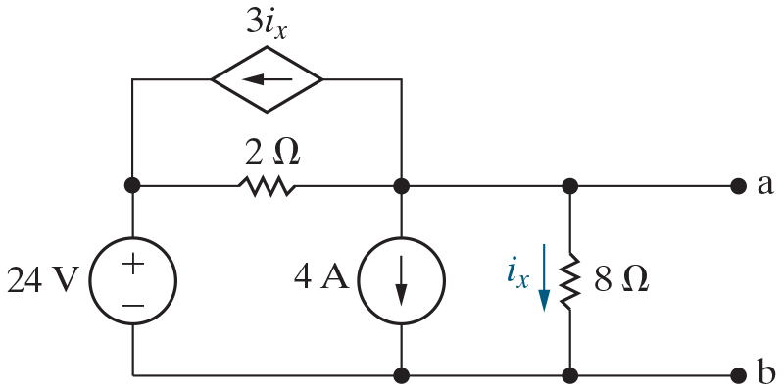


Chapter 4 – techniques of circuit analysis (6 of 17)
If we use the node voltage method to find the open-circuit voltage, how many K C L equations will we write?
A. 0
B. 1
C. 2
D. 3

Slide 8

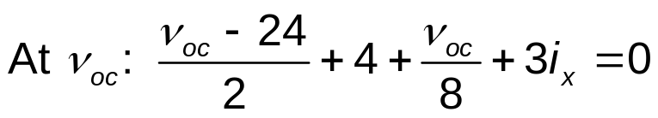
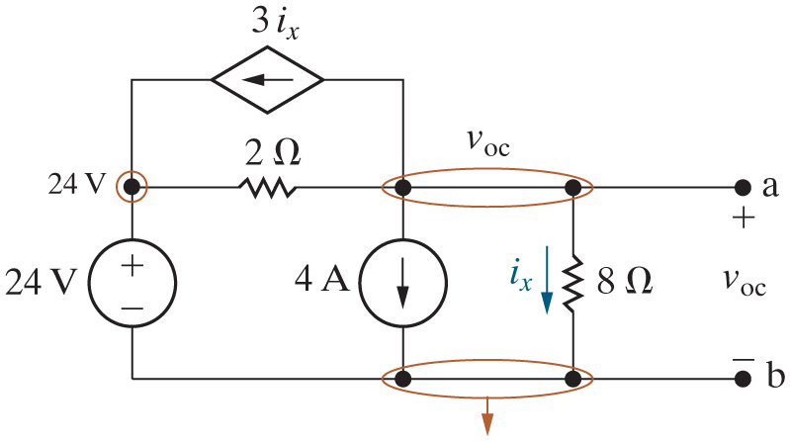
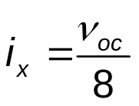

Chapter 4 – techniques of circuit analysis (8 of 17)
Thevenin and Norton equivalents
Find the Thevenin equivalent to the left of the terminals a,b in the circuit below.
Find
  using the node voltage method:
d.s. constraint:
Solving:

Slide 9

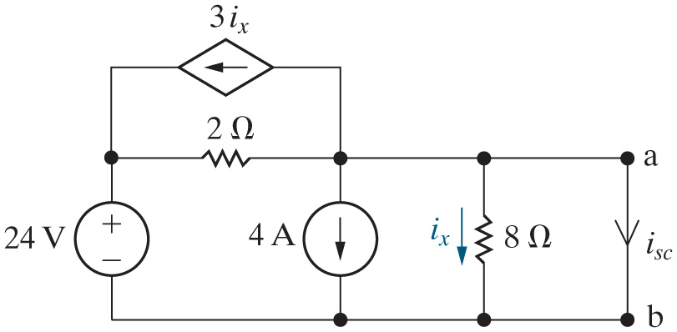


Chapter 4 – techniques of circuit analysis (9 of 17)
Thevenin and Norton equivalents
Find the Thevenin equivalent to the left of the terminals a,b in the circuit below.
Find
The short circuit eliminates the branch with the
resistor from the
circuit, which sets
and eliminates the dependent source. The
simplified circuit is shown and analyzed on the next slide.

Slide 10
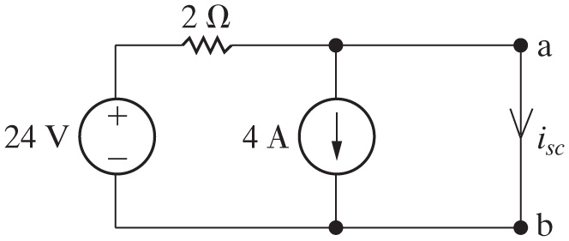

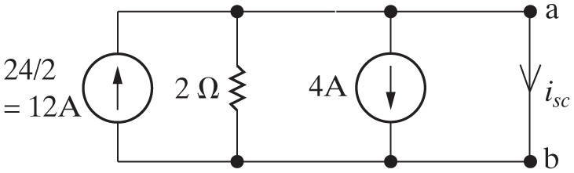

Chapter 4 – techniques of circuit analysis (10 of 17)
Thevenin and Norton equivalents
Find the Thevenin equivalent to the left of the terminals a,b in the circuit below (continued)
Find
(continued):
Source transform this circuit to get:
The sum of the currents flows in the short circuit, which bypasses the
branch with the
resistor. Thus, the short circuit current is 12 – 4 = 8 A.

Slide 11

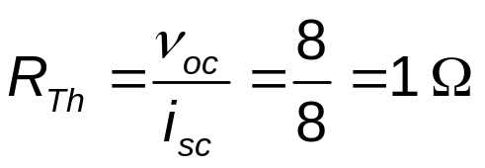
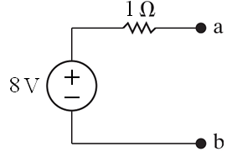
Chapter 4 – techniques of circuit analysis (11 of 17)
Thevenin and Norton equivalents
Find the Thevenin equivalent to the left of the terminals a,b in the circuit below (continued)
Find
and draw the Thevenin equivalent circuit:

Slide 12
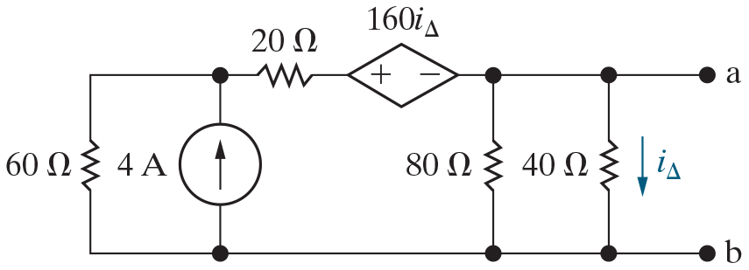
Chapter 4 – techniques of circuit analysis (12 of 17)
By using the test source method on this circuit, we will be able to find
A. The Thevenin equivalent resistance
B. The open circuit voltage
C. The short circuit current
D. All of the above

Slide 13
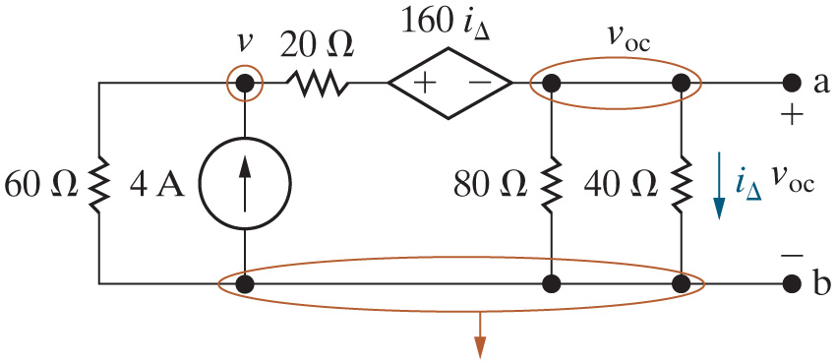

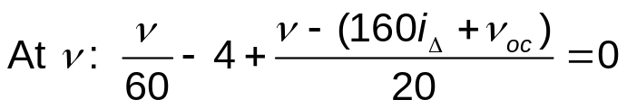
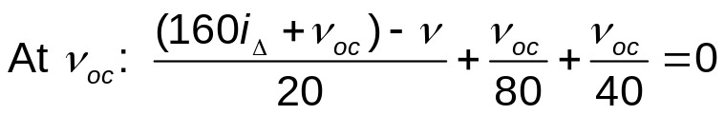
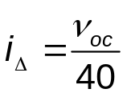

Chapter 4 – techniques of circuit analysis (13 of 17)
Thevenin and Norton equivalents
Find the Thevenin equivalent to the left of the terminals a,b in the circuit below. Use the test source method.
Find
  using the node voltage method:
d.s. constraint:
Solving:
Notes:
Long Description:
At v subscript o c Base Line: Start Fraction Open Parenthesis 160 i subscript Delta Base Line plus v subscript o c Base Line Close Parenthesis minus v over 20 End Fraction plus Start Fraction v subscript o c Base Line over 80 End Fraction plus Start Fraction v subscript o c Base Line over 40 End Fraction equals 0.

Slide 14
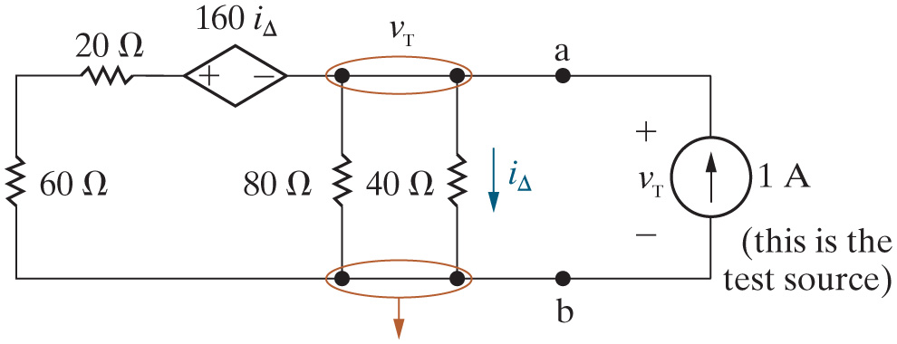
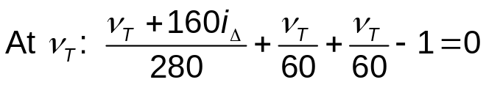
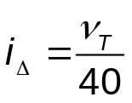

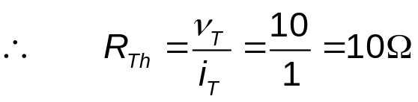
Chapter 4 – techniques of circuit analysis (14 of 17)
Thevenin and Norton equivalents
Find the Thevenin equivalent to the left of the terminals a,b in the circuit below. Use the test source method(continued)
Find
using the test source
method – don’t forget to kill the independent sources!
d.s. constaint:
Solving:
Notes:
Long Description:
At v subscript T Base Line: Start Fraction v subscript T Base Line plus 160 i subscript Delta Base Line over 280 End Fraction plus Start Fraction v subscript T Base Line over 60 End Fraction plus Start Fraction v subscript T Base Line over 60 End Fraction minus 1 equals 0.

Slide 15
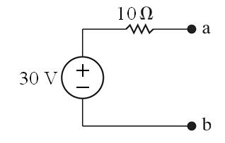
Chapter 4 – techniques of circuit analysis (15 of 17)
Thevenin and Norton equivalents
Find the Thevenin equivalent to the left of the terminals a,b in the circuit below. Use the test source method (continued)
Draw the resulting Thevenin equivalent circuit:

Slide 16
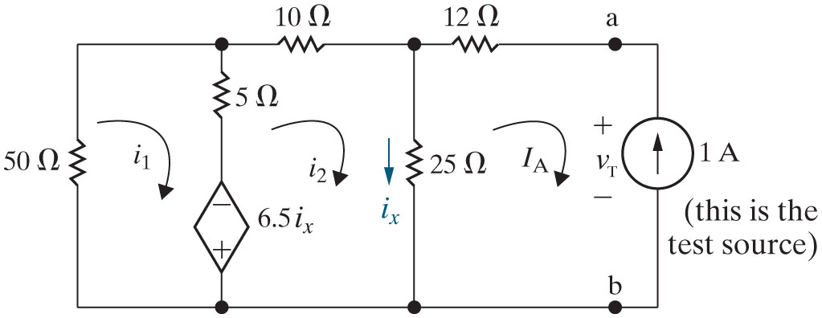




Chapter 4 – techniques of circuit analysis (16 of 17)
Thevenin and Norton equivalents
Find the Thevenin equivalent to the left of the terminals a,b in the circuit below. Use the test source method.
mesh:
mesh:
d.s. constraint:
Solving:

Slide 17



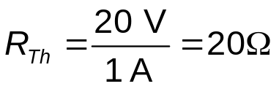

Chapter 4 – techniques of circuit analysis (17 of 17)
Thevenin and Norton equivalents
Find the Thevenin equivalent to the left of the terminals a,b in the circuit below. Use the test source method (continued)
K V L left mesh:

Slide 18

Copyright
This work is protected by United Kingdom copyright laws and is provided solely for the use of instructors in teaching their courses and assessing student learning. Dissemination or sale of any part of this work (including on the World Wide Web) will destroy the integrity of the work and is not permitted. The work and materials from it should never be made available to students except by instructors using the accompanying text in their classes. All recipients of this work are expected to abide by these restrictions and to honor the intended pedagogical purposes and the needs of other instructors who rely on these materials.

